Slide 1

Lecture 1
Notes:
Software Testing

Slide 2
Testing -Definition
Software testing is a process used to identify the correctness, completeness and quality of developed software.
It find defects and errors.
Method to Verify and Validate a product.
Notes:
Software Testing

Slide 3
V&V
Validation: Are we building the right system?
The software should do what the user really requires.
Verification: Are we building the system right?
The software should conform to its specification.

Slide 4
Fundamental principles of Testing
Apply input
Observe output
Software
Validate the observed output against the expected output
Is the observed output the same as the expected output?
Notes:
Software Testing

Slide 5
Fundamental principles of Testing
Exhaustive Testing is not possible. Testing must show the presence of defects never their absence.
      Exhaustive Testing –use all possible combinations of inputs
      Choose the subset of tests that can uncover the maximum number of errors .
Notes:
Software Testing

Slide 6
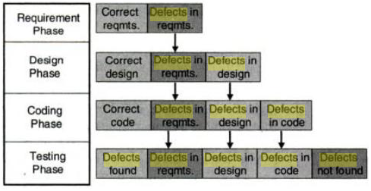
Fundamental principles of Testing
Testing applies all through the software life cycle and is not an end.
Notes:
Software Testing

Slide 7
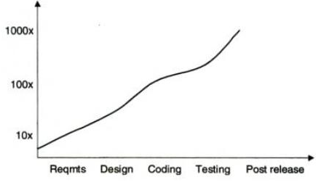
Fundamental principles of Testing
    How defects from early phases add to the costs
    The cost of building a product and the number of defects in it increase steeply with number of defects allowed to seep into the later phases
    Compounded effect of defects on software costs
Notes:
Software Testing

Slide 8
Fundamental principles of Testing
Defects occur in convoys or clusters and testing should focus on these convoys
      Testing can only find a part of defects that exists in a cluster; fixing this defects may introduce another defect to the cluster
Notes:
Software Testing

Slide 9
Fundamental principles of Testing
Testing encompasses defect prevention
    It may not be possible for testers themselves to carry out preventive action. Testers would have to work with development engineers to do that.
Notes:
Software Testing

Slide 10
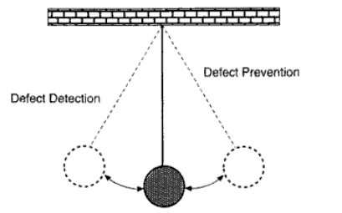
Fundamental principles of Testing
Testing is fine balance of defect prevention and defect detection
    Defect prevention and defect detection should supplement each other and not be considered as mutually exclusive
Notes:
Software Testing

Slide 11
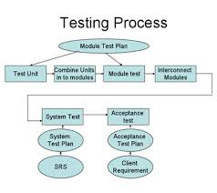
Levels of Testing
Unit testing
Integration testing
System testing
Acceptance testing
Regression testing

Slide 12
Test Strategies
Black-box or behavioral testing
  knowing the specified function a product is to perform and demonstrating correct operation based solely on its specification without regard for its internal logic
White-box or glass-box testing
  knowing the internal workings of a product, tests are performed to check the workings of all possible logic paths

Slide 13
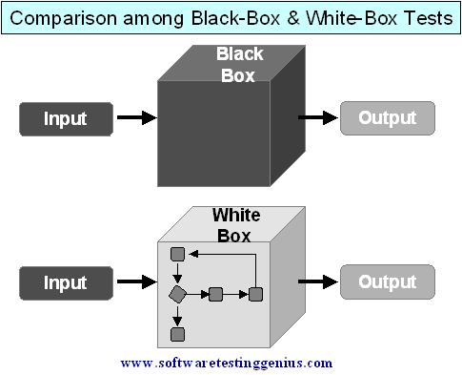
Black Box V/S White Box

Slide 14
White box testing
It also known clear box testing, glass box testing, open box testing
It takes into account the
    Program code
    Code structure
    Inernal design
Notes:
Software Testing

Slide 15
White box testing
Static
Structural
Desk Checking
Unit/Code
functional
testing
Code
coverage
Code
complexity
Code walk through
Statement Coverage
Code Inspection
Cyclomatic
complexity
Path Coverage
Condition Coverage
Function Coverege
Notes:
Software Testing

Slide 16
Static testing
Requires only source code of the product,not binaries or executables
Does not involve executing the programs
Find out whether the
    The code works according to the functional requirements
    The code has been written in accordance with design
    The code for any functionality has been missed out
    The code handles errors properly
Can be performed by humans or using specialized tools
Notes:
Software Testing

Slide 17
Formal Inspection
There are 4 roles in inspection
  Author of the code
  Moderator –who is expected to formally run the inspection
  Inspectors- provides review comments for the code
  Scribe- who takes detailed notes during the inspection meeting and circulate them to the team after the meeting
Notes:
Software Testing

Slide 18
Structural testing
Takes into account the code, code structure and internal design and how they are coded
Fundamental difference between structural and and static testing
  Static –the product is tested by the humans using just the code
  Structural-tests are actually run by the computer on built product
Notes:
Software Testing

Slide 19
Structural testing-unit/code functional testing
The developer can perform certain obvious tests, knowing the input variables and the corresponding expected output variables
For modules with complex logic or conditions, the developer can build debug version of product by putting intermediate print statements and making sure the program is passing through the right loop and iterations the right no of times
Run the product under debugger or an IDE. It allows single stepping of instructions
These are done to understand the code structure
Notes:
Software Testing

Slide 20
Structural testing- code coverage Testing
Involves designing and executing test cases and finding out the percentage of code that is covered by testing
code overage testing is made up of following types of coverage
    Statement overage
    Path overage
    condition overage
    Function overage
Notes:
Software Testing

Slide 21
code coverage Testing – statement coverage
      Inorder to make sure that there is better statement coverage for statement within loop there should be test cases that
        Skip the loop completely
        Exercise the loop between once and maximum number of times to check all possible operations of the loop
        Try covering the loop, around the boundary of n
Notes:
Software Testing

Slide 22
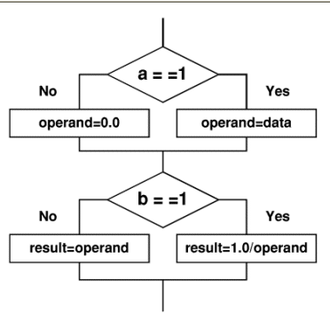
code coverage Testing - path coverage
A
Possible Paths
C
A-B-D
A-C-D
A-B-E
A-C-E
B
E
D
Notes:
Software Testing

Slide 23
Black box testing
    It is done from the customer’s view point
    Ensure functionality and capability of the software
    It is done without the knowledge of the internals of the system under test
    Requires functional knowledge of the product to be tested
Notes:
Software Testing

Slide 24
Why Black box testing
    It is based on requirements
    Black box testing addresses the stated requirements as well as implied requirements
    It enompasses the end user perspetives
    Handles valid and invalid inputs
Notes:
Software Testing

Slide 25
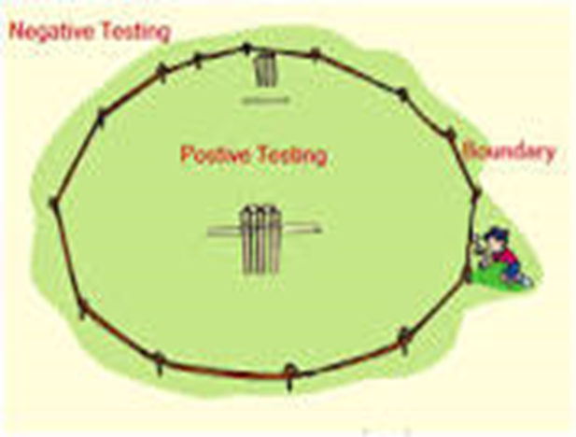
Various techniques in Black Box Testing
    Positive and negative testing
    Boundary value analysis
    Equivalene partioning
    State based testing
    User dumentation Testing
Notes:
Software Testing

Slide 26
Equivalence Partitioning
Partition the test cases into "equivalence classes"
Each equivalence class contains a set of "equivalent" test cases
Two test cases are considered to be equivalent if we expect the program to process them both in the same way (i.e., follow the same path through the code)
If you expect the program to process two test cases in the same way, only test one of them, thus reducing the number of test cases you have to run

Slide 27
Equivalence Partitioning
First-level partitioning: Valid vs. Invalid test cases
Valid
Invalid

Slide 28
Equivalence Partitioning
Partition valid and invalid test cases into equivalence classes

Slide 29
Equivalence Partitioning
Create a test case for at least one value from each equivalence class

Slide 30
Boundary Value Analysis
When choosing values from an equivalence class to test, use the values that are most likely to cause the program to fail
Errors tend to occur at the boundaries of equivalence classes rather than at the "center"
  If (200 < areaCode && areaCode < 999) { // valid area code }
  Wrong!
  If (200 <= areaCode && areaCode <= 999) { // valid area code }
  Testing area codes 200 and 999 would catch this error, but a center value like 770 would not
In addition to testing center values, we should also test boundary values
  Right on a boundary
  Very close to a boundary on either side

Slide 31
Boundary Value Analysis - examples
Input | Boundary Cases
A number N such that: -99 <= N <= 99 | -100, -99, -98 -10, -9 -1, 0, 1 9, 10 98, 99, 100
Phone Number Area code: [200, 999] Prefix: (200, 999] Suffix: Any 4 digits | Area code: 199, 200, 201 Area code: 998, 999, 1000 Prefix: 200, 199, 198 Prefix: 998, 999, 1000 Suffix: 3 digits, 5 digits

